Slide 2
BY AGHA MASHOOQUE ALI Deputy General MANAGER (CD) Faran Sugar Mills Ltd
55TH ANNUAL PSST CONVENTION
Management of Cane Harvesting and Smart Farming to Boost Sugarcane Production.

Slide 3
ABSTRACT
Harvesting is a complex process that involves careful cutting and handling procedure to maintain quality production. Sugarcane production is affected by both harvesting and field issues. The aim of program harvesting is to facilitate a regular skilled labours harvesting tools and economical transport of sugarcane consignments to the mill.
The research study and different field data found 14-19 mds per acre higher sugar recovery, cane losses at field and poor ratooning (Low yield) due to improper harvesting practices. The aim of this paper is to evaluate the current harvesting system with regard to production efficiency, enhancing quality yield by adopting innovative smart farm management practices. The key to successful sustainability will ultimately depend on the progress in sugarcane productivity without increasing the cultivated area and decreases environmental impacts. Smart farming is the need of the day and it will ensure the profitability and sustainability of the grower’s economics as well as entire sugarcane industry.

Slide 4
INTRODUCTION
Harvesting is a complex process that involves careful cutting and handling procedure to maintain high sugar content and quality. The aim of programmed harvesting is to facilitate a regular skilled labour force, harvesting tools and economical transport of cane consignments to the Mill, in order to obtain the maximum available sugar from a given variety. In many countries even today, harvesting is done manually, using various types of harvesting tools i.e Axes, Sickle (Daranti), hand knives. Among the several tools the smart harvesting knife is light weight (aggressive) and facilitates easier and efficient cutting of cane from ground level. Manual harvesting requires skilled labours as improper harvest of cane leads to loss of cane sugar yield. Most of the new sugar mills have higher crushing capacity and many are expanding their crushing capacities. Their daily requirement of cane is increasing and hence greater demand for harvesting labour. In future may face scarcity of labour and harvesting cost will also increase. Therefore farmers’ will have to adopt proper harvesting techniques and move to mechanized harvesting system to control in-field losses and focus on better Ratoon management practices, for improving the production per unit area. The research study and different Field data’s found that to avoid wastage of high sugar recovery cane available at the bottom of sugarcane plant. We have estimated that 14-19 mds cane remains in the fields due to usual tools and operations. This leftover cost approx 6000/- Rupees per acre which is a huge loss. Improper harvesting results in low sprouting and yield reduction in ratoon crop.
We should adopt smart farming which is the key component of agriculture sector. With the advancement of technology the yields will enhance and it will ensure the profitability and sustainability of all stack holders.

Slide 5
METHODOLOGY
The study was carried out in Faran Sugar Mills Operational Areas District Tando Mohammad Khan Longitude 68.405259 °E and Latitude 26.262201 °N and covered cultivated sugar cane crop approx: 18000 acres source of irrigation is canal and underground water. FSML located in tail area approx: 43% area facing shortage of irrigation water.
DATA COLLECTION
The method of data collection was a simple random system where respondents were selected from each economical zone. Questionnaires were administered to respondents which was the main source of data collection for the research work and this was complimented by oral interview, field observation data and other sources.

Slide 6
KEY WORDS
To improve harvesting system as future needs.
This study is to provide the information & discussion in the adoption of smart farming techniques in sustainability of the sugarcane crop.

Slide 7
EFFICIENT HARVESTING PROGRAM
The first step towards cane harvesting programme in the crushing season needs information on:
Available quality cane in operational area.
Varietal composition.
Crop classification.
Crop condition.
Quality parameters described.
Periodic juice and analysis of the cane block-wise.
Pest and disease infestation data.

Slide 8
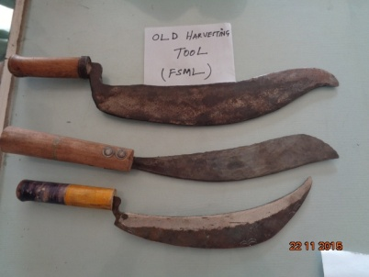
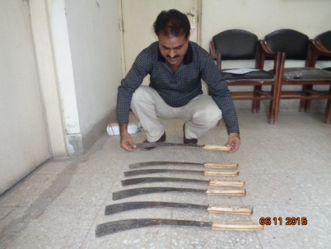
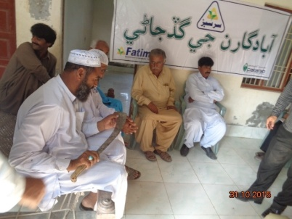
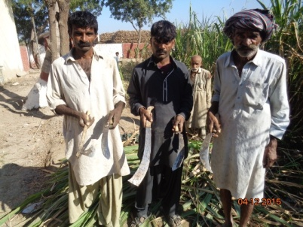
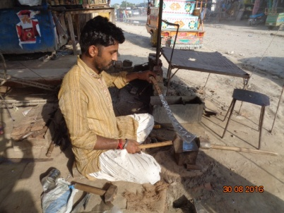
SUGARCANE HARVESTING TOOLS USED IN SINDH PROVINCE
Comparison of Harvesting Tools
Different Type of Sickles
Smart Harvesting Knife
Demonstration in Growers Meeting
Demonstrate Harvesting Tools
Smart Harvesting Knife under Preparation

Slide 9
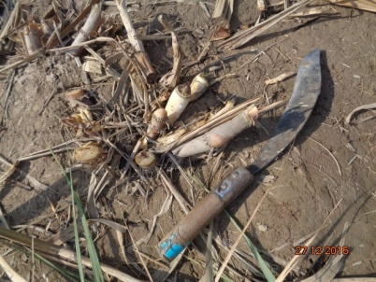
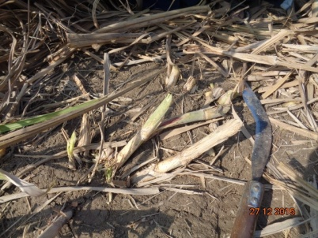
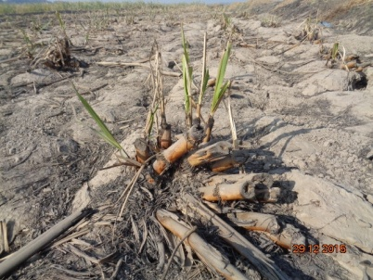
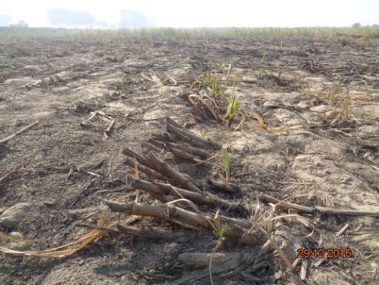
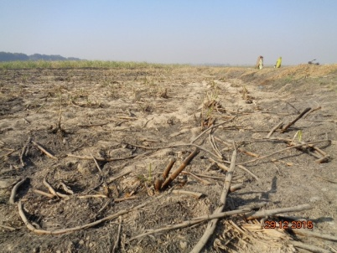
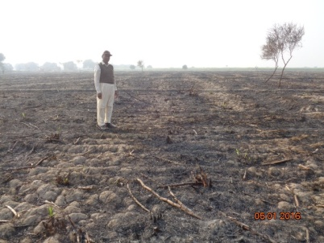
PICTORIAL VIEW OF IN-FIELD LOSSES
Cane Harvested by Sickle
Cane Harvested by Sickle
Poor Sprouting due to Improper Harvesting
In-Field Loss due to Improper Harvesting
In-Field Losses due to Improper
Harvesting
In-Field Losses

Slide 10
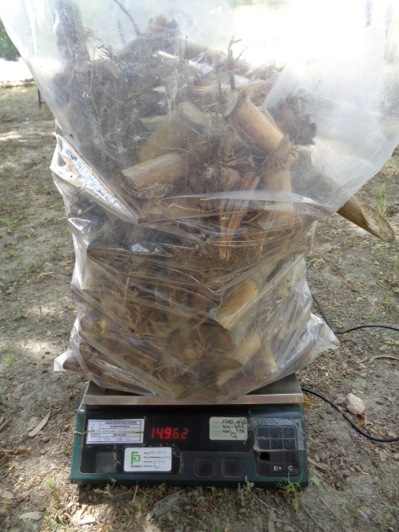
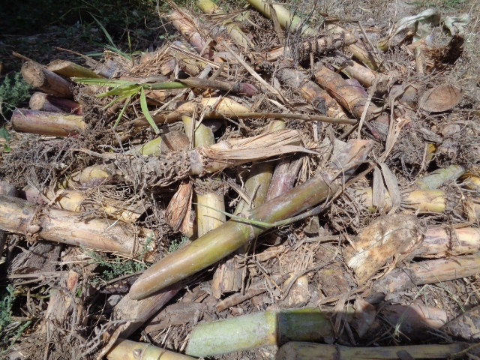
MEASURED IN-FIELD LOSSES

Slide 11
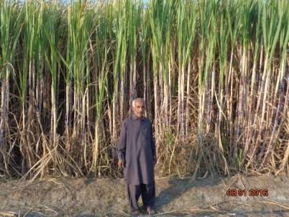
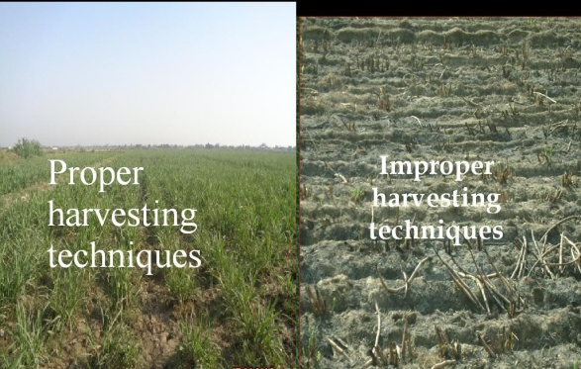
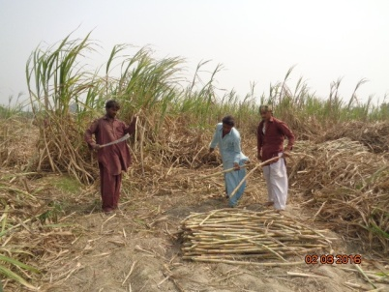
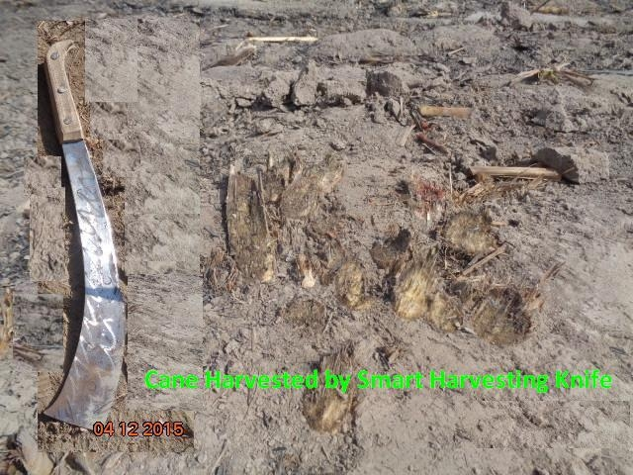
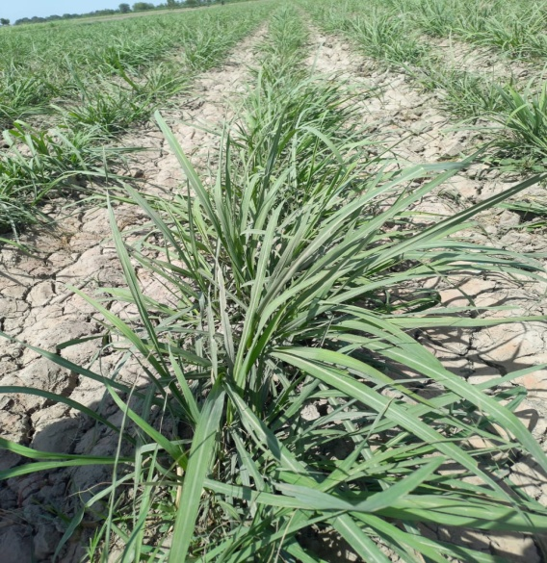
SMART FARMING Pictorial View
Proper Harvested Ratooning Crop
Cane Harvested by Smart Harvesting Knife

Slide 12
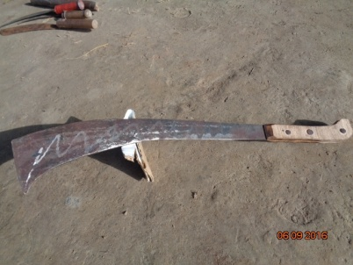
CHOOSE SMART HARVESTING KNIFE
Before cutting sugarcane you need a harvesting Tool. Sugarcane is strong. So sharp cutting blade is necessary to cut the crop properly. A sharp knife is suitable tool for harvesting of sugarcane. Smart harvesting knife with large cutting blade, is your best choice. It can efficiently cut down sugarcane. Cut cane close to ground.
The Smart Harvesting Knife is characterized as:
A hard wood handle 6”.5” inches
Length 22” inches
Deep Curved Blade width 4” inches

Slide 13
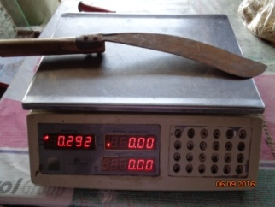
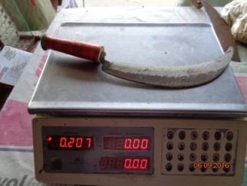
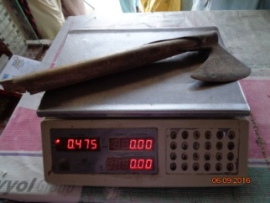
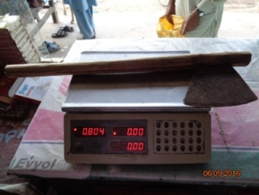
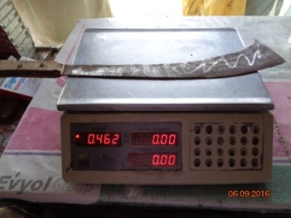
COMPARISON OF DIFFERENT HARVESTING TOOLS IN SINDH PROVINCE
Sr.# | Tool | Weight (gram) | Harvesting Efficiency Mds/day per Labour Cutting | Pictures
1 | Big Sickle | 0.292 | 38-45
2 | Small Sickle | 0.207 | 30-38
3 | Axe | 0.475 | 40-50
4 | Long Wood Handle Axe (common used in Punjab & Sindh) | 0.804 | 45-50
5 | Smart Harvesting Knife | 0.462 | 45-55

Slide 14
SECTOR WISE IN-FIELD LOSSES DUE TO IMPROPER HARVESTING
Sr. # | Sector | Surveyed No. of Fields | In-field Losses Per Acre (Mds)
1 | Jhan Mori | 12 | 17
2 | Gate-1 | 12 | 14.5
3 | Gate | 13 | 19
4 | Digh Mori | 10 | 14
5 | Khokhar | 10 | 19.5
6 | Daro Sandi | 09 | 18
Total |  | 66 | -
During study, found maximum in-field losses where harvesting was done by Sickle and secondly cut for fodder purpose.
In-field losses recorded 14-19 mds, per acre.

Slide 15
ADVANTAGES OF THE PROPER HARVESTING
Yield increased per unit area.
Labour saving.
Additional Sugar Recovery.
Quick and more tillering.
Better Ratooning.
Cost saving per unit area.

Slide 16
LOSSES IN SUGARCANE WEIGHT FROM HARVESTING TO CRUSH
Source: P.W on Agriculture 2010 P-58

Slide 17
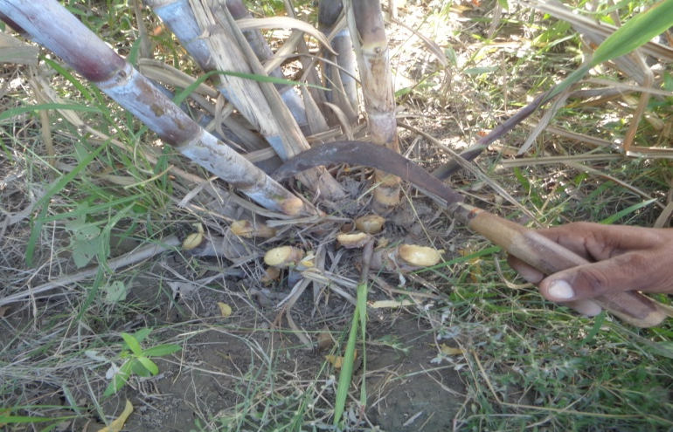
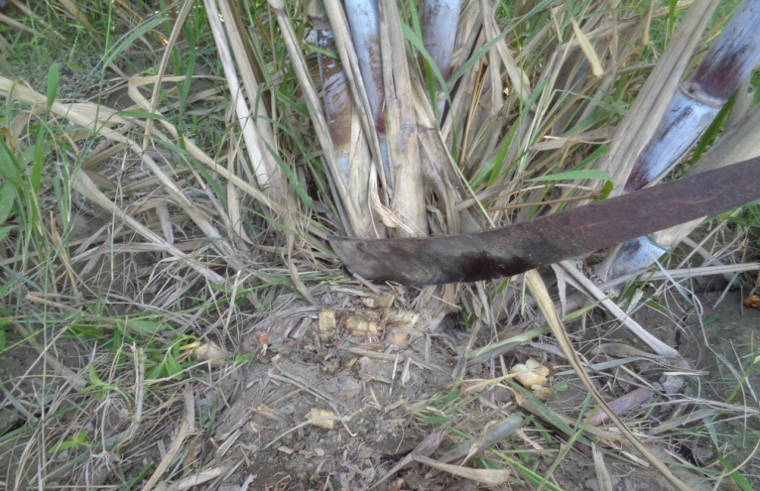
HARVESTING TECHNIQUES
To harvest the cane at peak maturity (i.e. avoiding cutting of either over – aged or under aged cane).
Cutting cane from ground level for maximum sugar yield.
De-topping at appropriate height so that green immature tops are eliminated.
Proper cleaning of the cane i.e. removing the extraneous material such as dry leaves – trash and roots etc.
Cut to crush time.
Avoid cane harvesting with Sickle.
To choose the smart harvesting knife which help faster – easier – aggressive and efficient cutting from ground level.
To adopt mini sugarcane harvester for smooth and economical harvesting.
Traditional Harvesting Tool (Sickle)
Proper harvesting with (Smart Harvesting Knife)

Slide 18
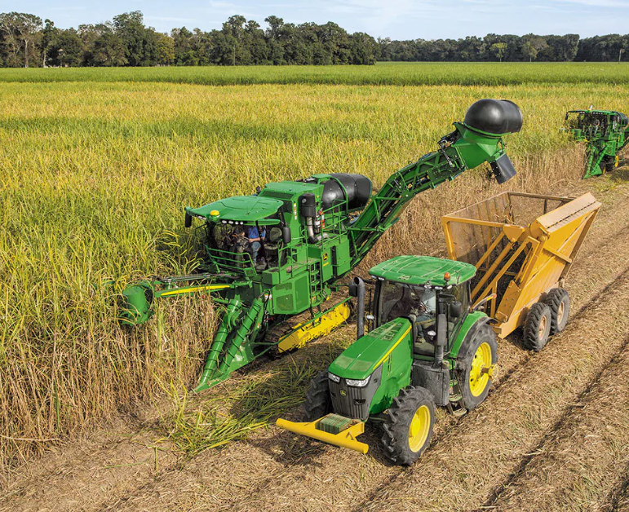
CUT YOUR LOSSES Harvesting is Getting Smarter
Sugarcane Planter is latest technology adopted by developed countries which is economical and it uses smart clean technology which is an integrated solution that works with Harvest Monitor to control primary extractor losses and trash levels, improving yield , sugar recovery, time saving and reducing costs.
Smart Farming
Technology in farming have been utilized in numerous ways, each kind is installed for different purpose. Based on the function, here are some advanced technologies applied as smart farming. The integration between technology and farmers’ skills is aimed to produce the maximum quality yields.

Slide 19
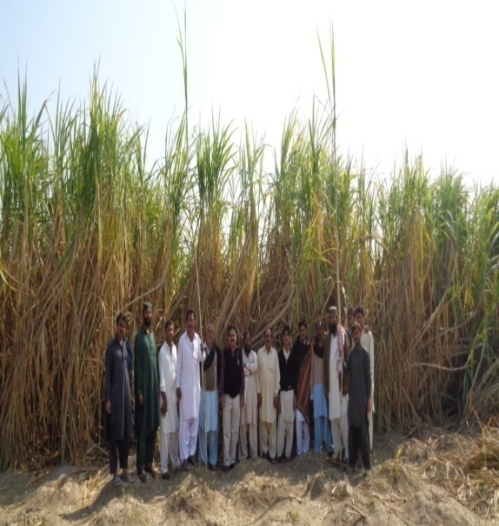
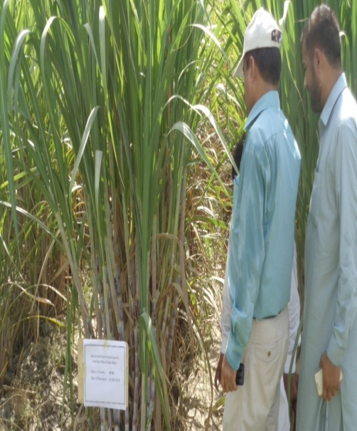
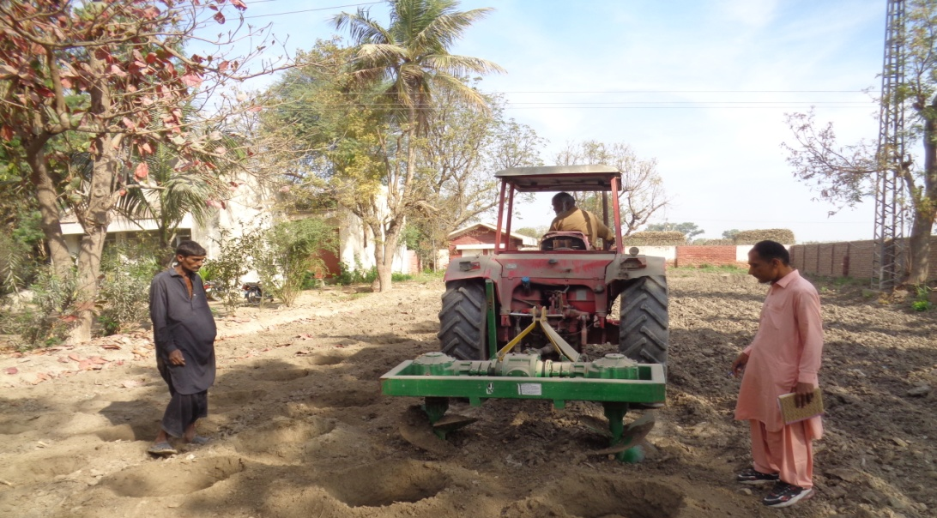
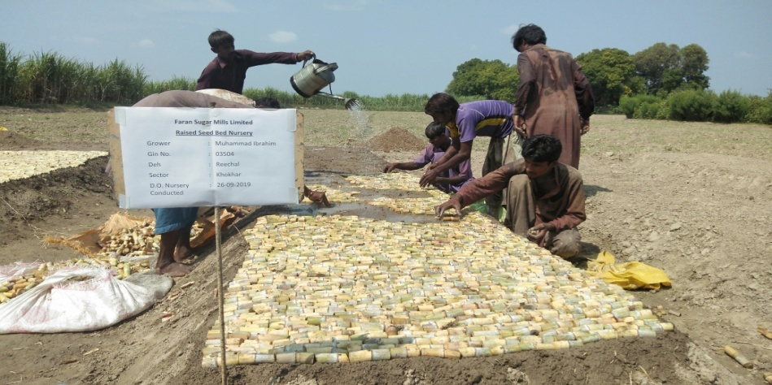
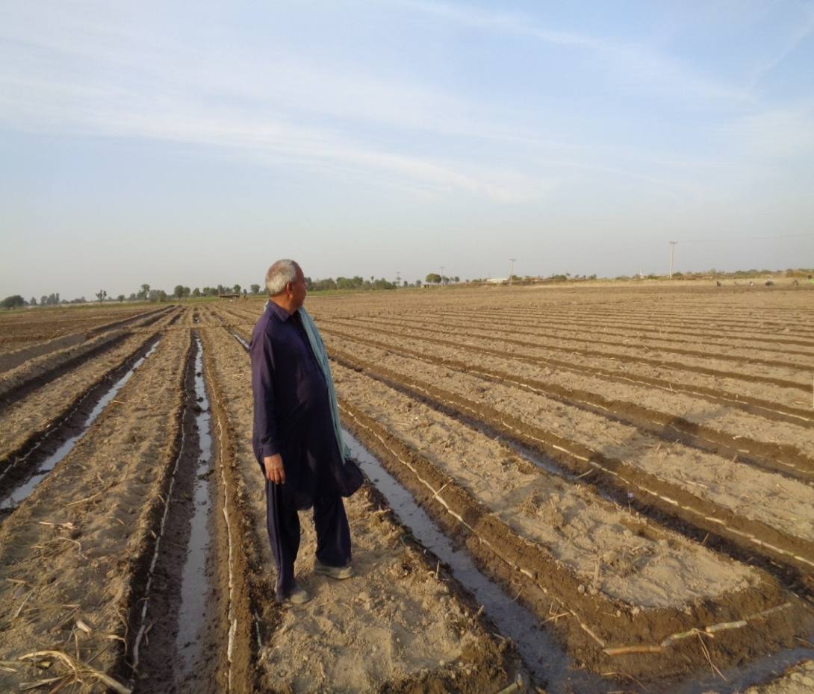
SMART FARMING
TECHNOLOGICAL ADVANCEMENT

Slide 20
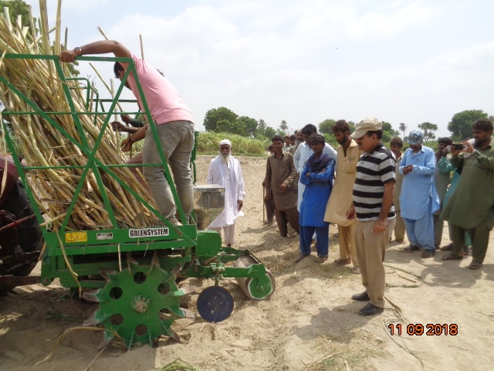
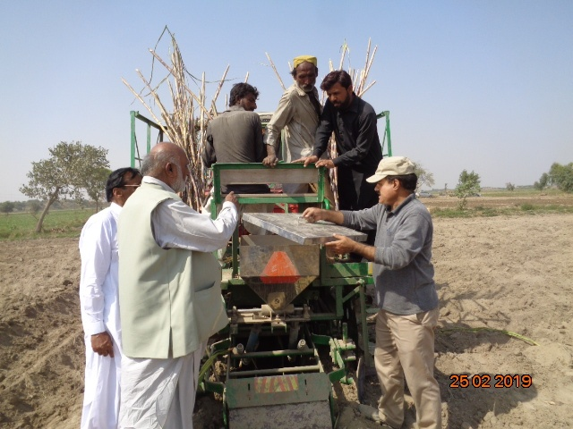
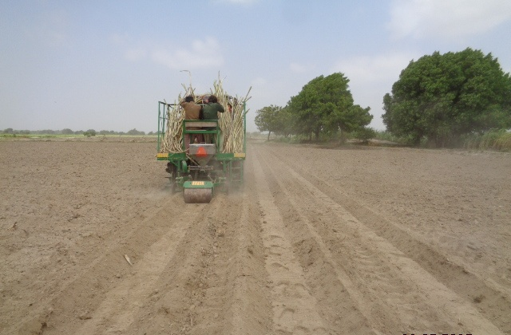
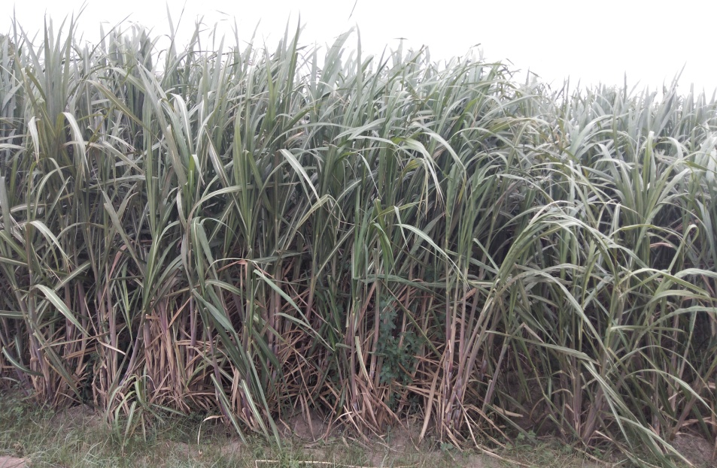
SMART FARMING
Mechanized Cultivation with Sugarcane Planter

Slide 21
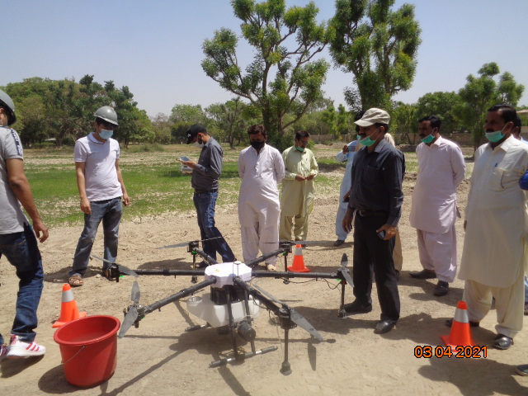
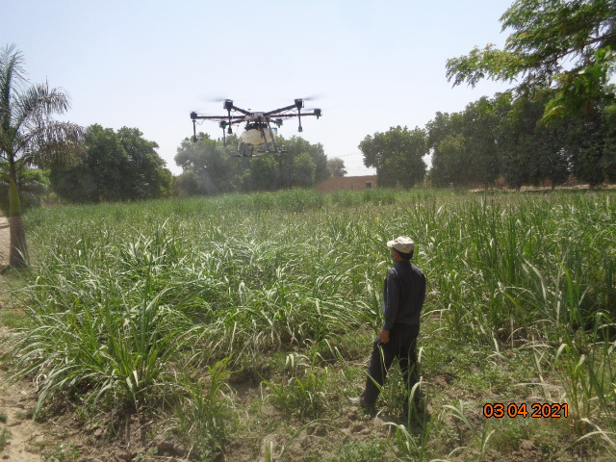
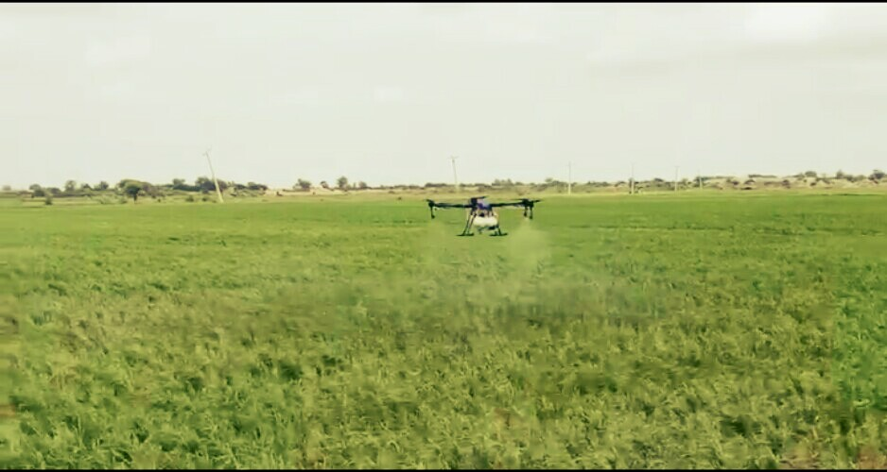
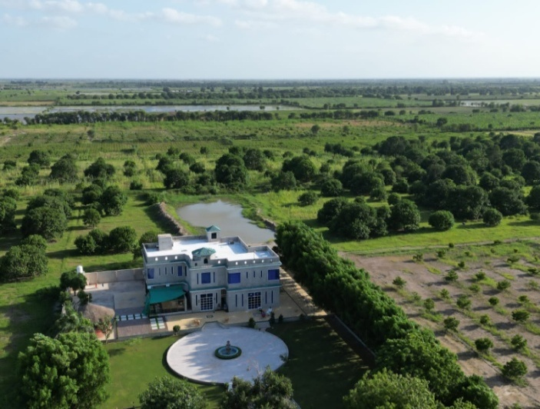
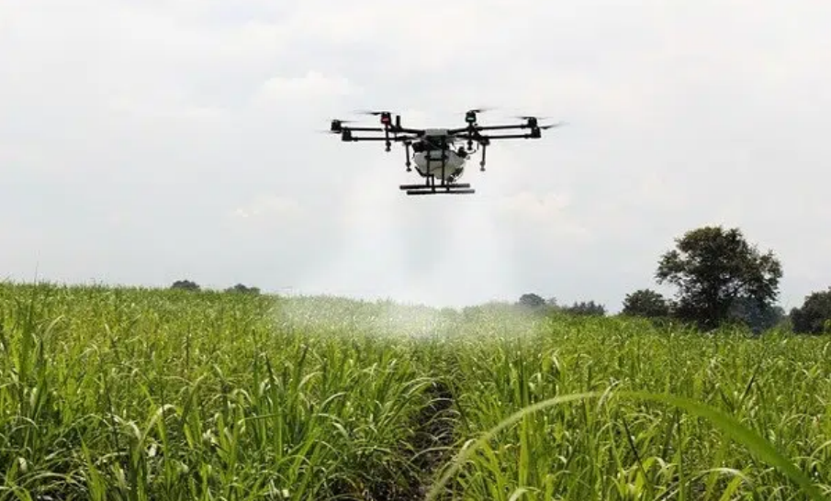
Smart Farming
Drone Technology used at FSML.
Dr. Azam Agri Farm
Nawab Ahmed Ali Talpur
Dr. Irfan Nizamani

Slide 22
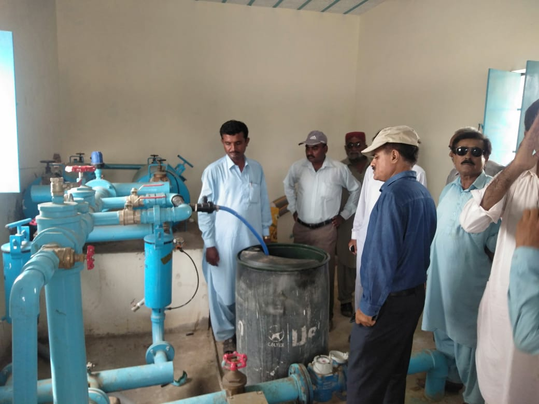
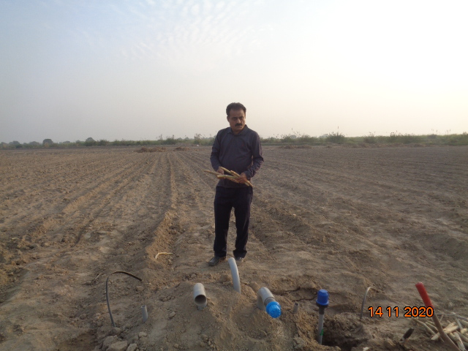
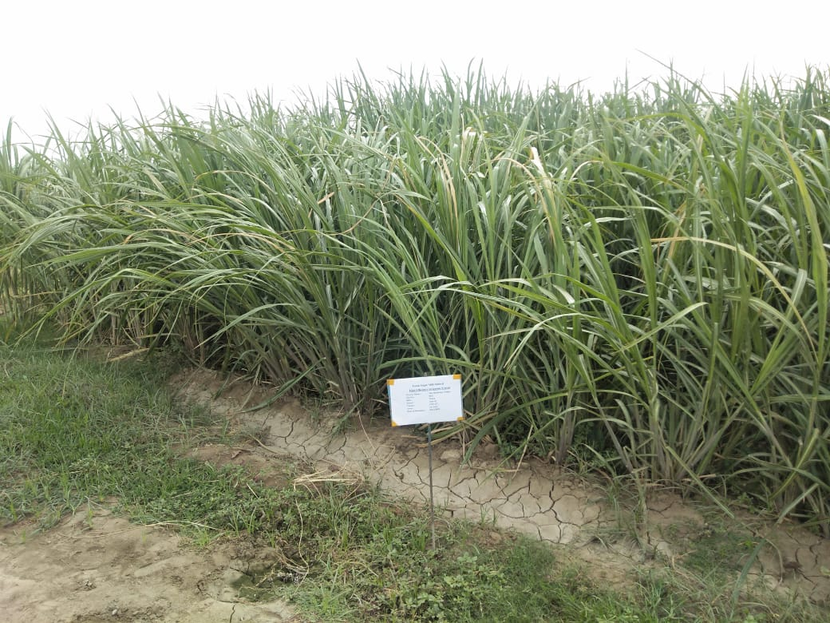
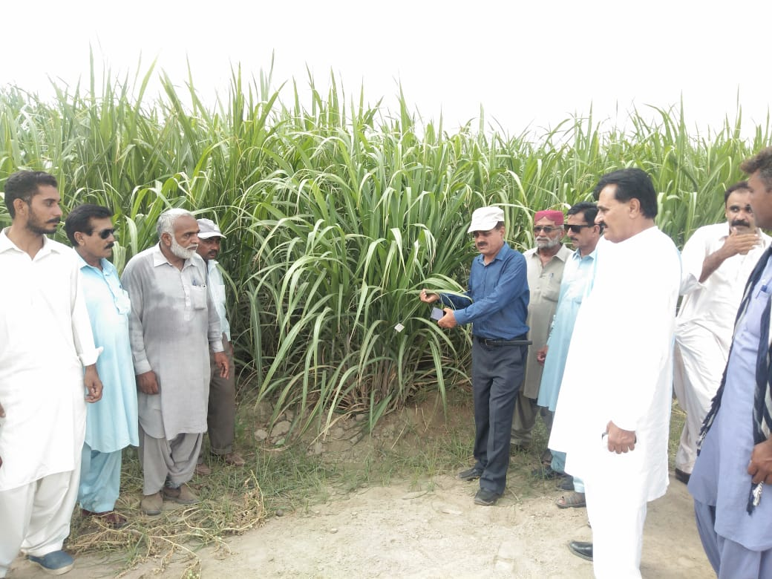
SMART FARMING High Efficiency Irrigation System (HEIS) Mir Mushtaque Agri. Farm Area Plant Crop 24 Acres & Ratoon Crop 24 Acres Plantation Date: 09/11/2020
Yield of plant crop: 1425mds
Yield of Ratoon crop: 1019mds

Slide 23
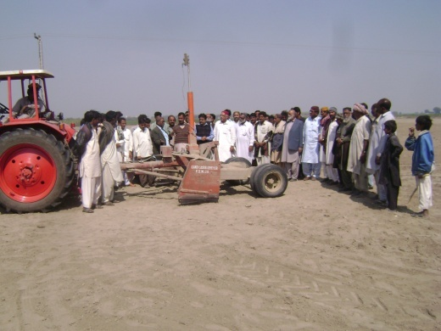
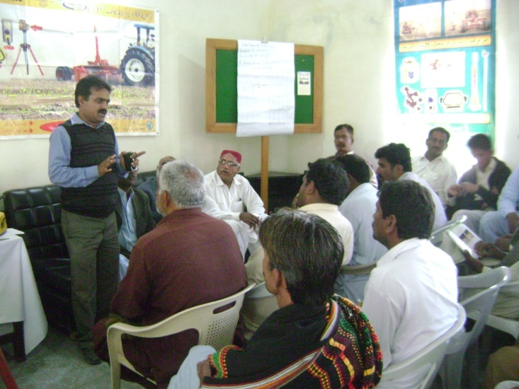
Smart Farming
5 Years Land Laser Leveling TARGET and Achievement at FSML Zone (Acre)

Slide 24
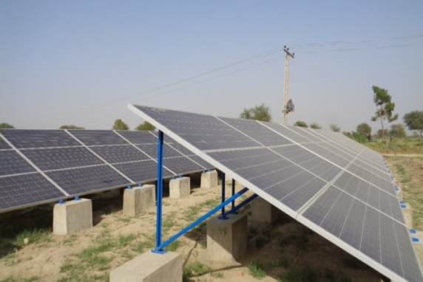
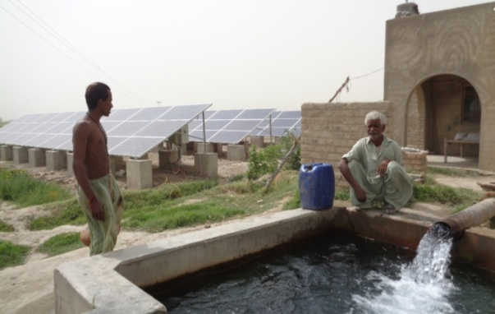
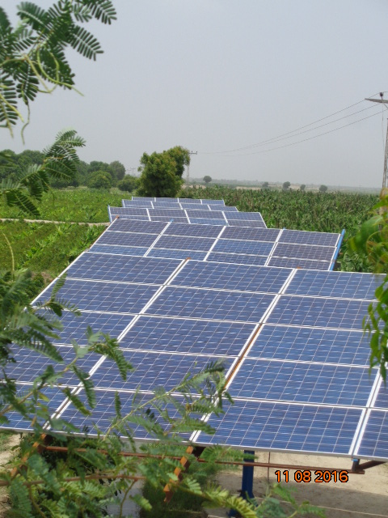
SMART FARMING ALTERNATIVE SOURCE OF ENERGY
Solar energy is the most promising renewable energy source that can replace the conventional source of energy
Year | No. of Solar Tube wells
2017 | 16
2018 | 56
2019 | 94
2020 | 114
2021 | 125
2022 | 172
We are saving approx
Rs. 1.7millions per day of growers with regard to fuel and electricity charges by applying solar energy at FSML zone.

Slide 25
Biological Control as Biological Pest Management
An integrated pest management program (IPM) approach integrates preventive and corrective measures to keep pest from causing significant problems. With minimum risk or hazard to human desirable components of their environment. Adoption of IPM strategies provide economic benefits due to sustainable development and increased quality productivity and control pest.
FSML Biological Lab

Slide 26
WAY FORWARD
Technological revolutions (smart farming) in sugarcane farming is future need for sustainable eco friendly, efficient management and cost-effective.
Farmer’s will have to adopt proper harvesting system to control the in-field losses for improve the quality productivity per unit area.
All Sugar Mills must plan to extend technological advancement in their operational areas for increasing productivity.

Slide 27
Thank You

